Slide 1
Digital Communication 22EC2208
AY 2023-24
Non-Uniform Quantization and DPCM

Slide 2
Digital Communication
Dr. M. Venu Gopala Rao
M.Tech, Ph.D(Engg) F.I.E.T.E, L.M.I.S.T.E, I.S.O.I., I.A.E., S.S.I.
Cert. in R.S.T ( City & Guild’s London Institute , London)
Professor, Dept. of ECE, K L University
mvgr03@kluniversity.in

Slide 3
Non-Uniform Quantization Companding

Slide 4
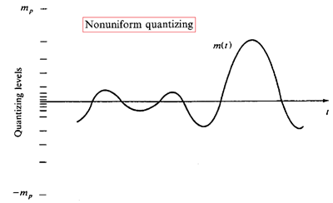
Problems with uniform quantization
Only optimal for uniformly distributed signal
Not efficient
In speech communication, it is found that smaller amplitudes predominate in speech and that larger amplitudes are relatively rare.
Real audio signals (speech and music) are more concentrated near zeros
Human ear is more sensitive to quantization errors at small values
Solution
Using non-uniform quantization
Quantization steps for small amplitudes

Slide 5
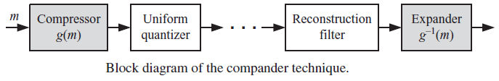
Companding

Slide 6

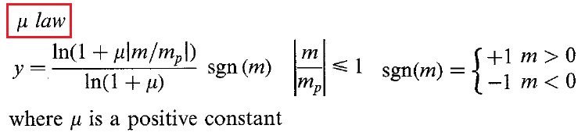
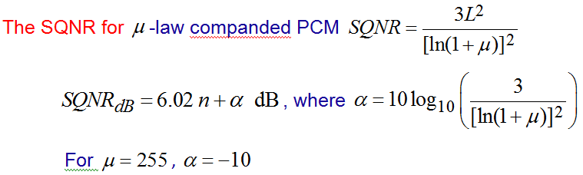
Compression
USA and Japan
SQNR

Slide 7
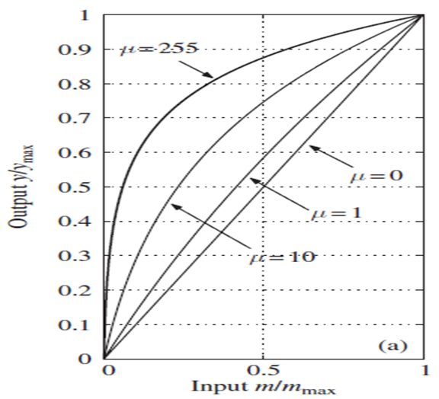
Characteristics

Slide 8
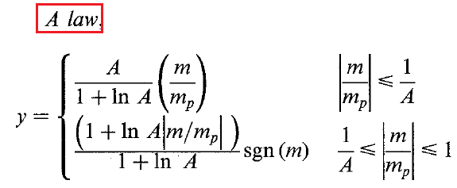
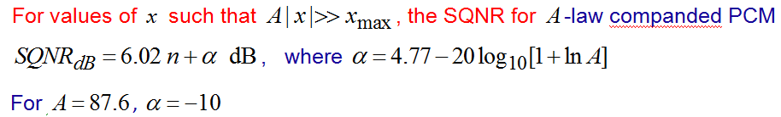
A-law Compression

Slide 9
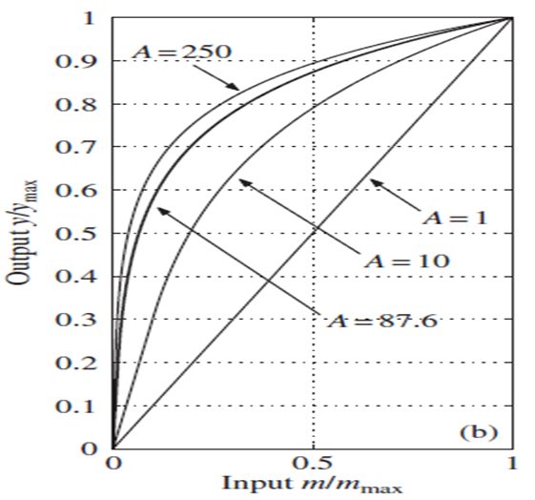
A-law Characteristics

Slide 10
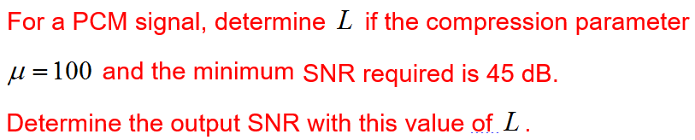
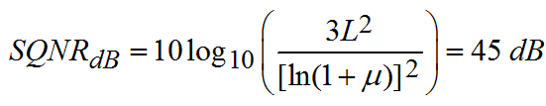





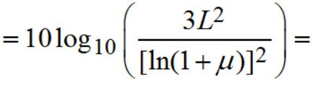


Ex1:
Ans:

Slide 11

Ex4: A speech signal up to 3.4KHZ is intend to transmit through a landline system. The signal is sampled at 8KHz and PCM requirement uses non-uniform quantizers. Calculate the number of bits required per sample to generate a SNR specification of 40db.
Ans: Assuming µ-law quantization, the number of bits required per sample is computed as
Thus the PCM bit rate for telephony voice is given by
High quality audio signals required much higher data rates than the required for telephone voice.

Slide 12
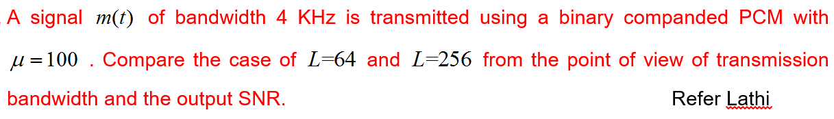
EX2

Slide 13
Advantages of PCM:
Relatively inexpensive
Easily multiplexed: PCM waveforms from different sources can be transmitted over a common digital channel (TDM)
Easily regenerated: useful for long-distance communication, e.g. telephone
Better noise performance than analog system
Signals may be stored and time-scaled efficiently (e.g., satellite communication)
Efficient codes are readily available
Disadvantage:
Requires wider bandwidth than analog signals
Quantization noise
Fidelity of a signal

Slide 14
Differential PCM (DPCM)
PCM is not a very efficient system because it generates large number of bits and requires high bandwidth to transmit.
In PCM encoding waveform, successive samples having little difference between them, This necessitates transmitting several identical PCM codes, which is redundant.
DPCM is designed specifically to take the advantages of the sample to sample redundancies in typical speech waveforms.
With DPCM, the difference in magnitude of two successive samples is transmitted rather than the actual sample.
Since the range of sample differences is typically less that the range of individual samples, fewer bits required for DPCM than the conventional PCM.

Slide 15


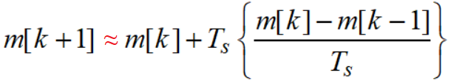

Signal Predictor (Estimator)
Consider a signal m(t) that has derivatives of all orders.
Using Taylor series,
For ‘k’th sample,
This shows we can predict(k+1)th sample from two previous samples.

Slide 16


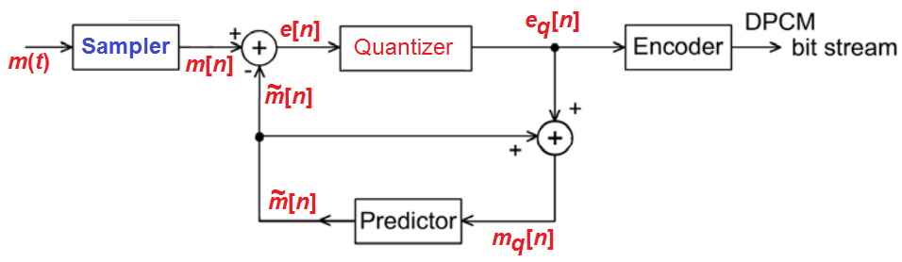


DPCM Transmitter

Slide 17
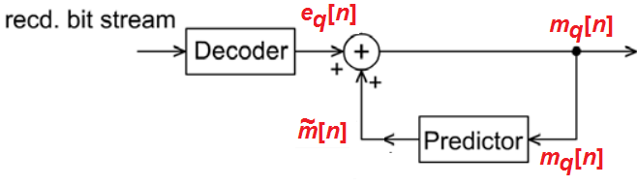

DPCM Receiver

Slide 18
Rate of Communication
The rate of communication: is the speed at which DIGITAL information is transmitted.
The maximum rate at which most of today’s modems receive digital information is around 56 k bits/second and transmit digital information is around 33 k bits/second.
A Local Area Network (LAN) can theoretically receive/transmit information at a rate of 100 M bits/s.
Gigabit networks would be able to receive/transmit information at least 10 times that rate.

Slide 19
Consider the input samples m(n) = {2.1,2.2,2.3,2.6,2.7,2.8}. Explain how encoding and decoding is done in DPCM. Assume first order prediction filter m~(n) = m_{q}(n-1)
ENCODER
m(n) i/p signal | m~(n) predict | e(n) error e[n] = m[n] – m~[n] | e_{q}(n) quan. Err. | m_{q}[n] = m~[n] + e_{q}[n]
2.1 | 0 | 2.1 | 2 | 0+2=2
2.2 | 2 | 0.2 | 0 | 2+0=2
2.3 | 2 | 0.3 | 0 | 2+0=2
2.6 | 2 | 0.6 | 1 | 2+1=3
2.7 | 3 | -0.3 | 0 | 3+0=3
2.8 | 3 | -0.2 | 0 | 3+0=3
TRANSMITTED SEQUENCE = { 2, 0, 0, 1, 0, 0}
010 000 000 001 000 000

Slide 20
DECODER
e_{q}(n) quan. Err. | m~(n) = m_{q}(n-1) | m_{q}[n] = m~[n] + e_{q}[n]
2 | 0 | 2+0=2
0 | 2 | 0+2=2
0 | 2 | 0+2=2
1 | 2 | 1+2=3
0 | 3 | 0+3=3
0 | 3 | 0+3=3
RECEIVED SIGNAL= {2, 2, 2, 3, 3, 3}

Slide 21
Using mid-riser quantization, find the DPCM output for the given input sequence x(n) = {0,0.3,1.5,0.7,1,2.3}. Assume first order prediction filter m~(n) = m_{q}(n-1)
ENCODER
m(n) i/p signal | m~(n) predict | e(n) error e[n] = m[n] - m[n] | e_{q}(n) quan. Err. | m_{q}[n] = m~[n] + e_{q}[n]
0 | 0 | 0 | 0.5 | 0+0.5=0.5
0.3 | 0.5 | -0.2 | -0.5 | 0.5-0.5=0
1.5 | 0 | 1.5 | 1.5 | 0+1.5=1.5
0.7 | 1.5 | -0.8 | -0.5 | 1.5-0.5=1
1 | 1 | 0 | 0.5 | 1+0.5=1.5
2.3 | 1.5 | 0.8 | 0.5 | 1.5+0.5=2
2.5
1.5
0.5
-3
-2
-1
0
1
2
3
-0.5
-1.5
-2.5
TRANSMITTED SEQUENCE = {0.5, -0.5, 1.5, -0.5, 0.5, 0.5}

Slide 22
DECODER
e_{q}(n) quan. Err. | m~(n) = m_{q}(n-1) | m_{q}[n] = m~[n] + e_{q}[n]
0.5 | 0 | 0.5+0=0.5
-0.5 | 0.5 | -0.5+0.5=0
1.5 | 0 | 1.5+0=1.5
-0.5 | 1.5 | -0.5+1.5=1
0.5 | 1 | 0.5+1=1.5
0.5 | 1.5 | 0.5+1.5=2
RECEIVED SIGNAL= {0.5, 0, 1.5, 1, 1.5, 2}

Slide 23
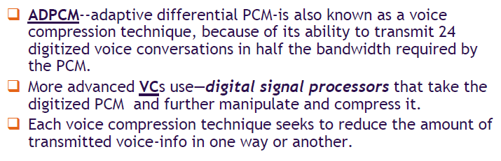
Voice Compression

Slide 24
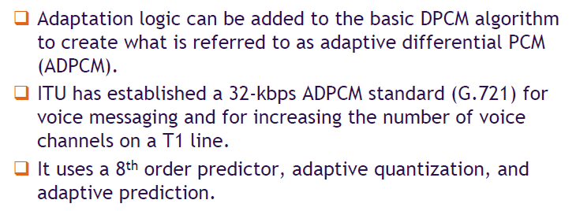
Adaptive Differential PCM

Slide 25
End

